Slide 1
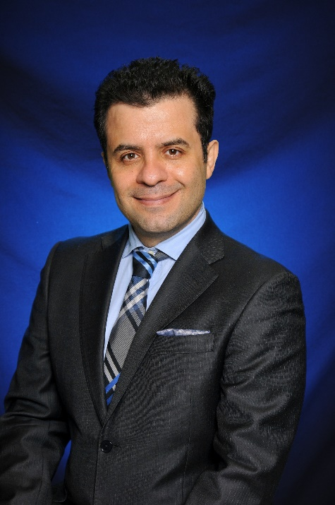
Tuesday Seminar Series
Penn Invited Speaker
Hassan Vahidnezhad, PhD
Associate Professor of Pediatrics
University of Pennsylvania Perelman School of Medicine and Children’s Hospital of Philadelphia
“Challenging Cases of Heritable Skin Diseases: Genomic Medicine, Pathogenesis, and Management”
January 9, 2024
Noon – BRB 1001 / Virtual via Zoom
For more information, please contact Anne.Rulinski@pennmedicine.upenn.edu
Sponsored by the Department of Dermatology, NIH T32: AR007465 “Dermatology Research Training Grant” & P30: AR069589 “Penn Skin Biology and Diseases Resources-based Center”

